Slide 1

Stock Analyst Agent
An n8n Workflow for Real-Time Financial AI Analysis

Slide 2
The Challenge: Data Overload
Information Overload: Investors are flooded with disconnected data points: price charts, technical indicators, and breaking news.
Missing Context: It's difficult to find the "what" (price changes) and the "why" (news drivers) in one place, quickly.
Manual Effort: Manually checking multiple APIs and Google for every stock is slow, repetitive, and not scalable.
Insight vs. Data: We don't just want raw data; we want actionable *insight* derived from that data.

Slide 3
The Solution: A "One-Message" Analyst
1
One Bot, Complete Analysis.
We built an AI agent in n8n that does all the work. The user sends a single stock ticker (e.g., "MSFT").
The bot fetches technical data, gets the company name, uses a tool to search for live news, and syntesizes it all into a single, comprehensive report.
Telegram Message

Slide 4
High-Level Workflow
2. Fetch
4. Reply
n8n fetches 3 parallel data streams from Alpha Vantage (Price, SMA, Overview).
The AI synthesizes all information into a final analysis and sends it to the user.
1. Trigger
3. Analyze
User sends a stock ticker (e.g., "AAPL") to the Telegram Bot.
The AI Agent analyzes the data and uses its SerpApi tool to find related news.

Slide 5
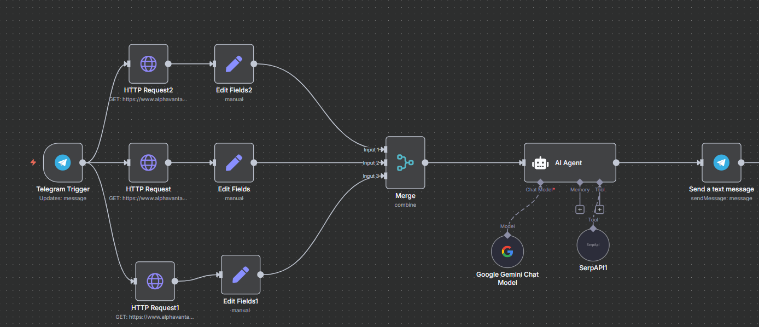
Workflow Architecture
Parallel Data, One Agent
The workflow is designed for speed and power. It runs three data-fetching branches in parallel:
•
Fetches 5-Day Price History
•
Fetches 20-Day Simple Moving Average
•
Fetches Company Overview (for the name)
A `Merge` node waits for all three to complete, combining them into a single data object for the AI agent.

Slide 6




Part 1: The Technical Data
Daily Prices
Momentum
Context
The `TIME_SERIES_DAILY` endpoint provides the 5-day price trend.
The `SMA` endpoint provides the 20-day Simple Moving Average.
The `OVERVIEW` endpoint provides the company's full name for the news search.

Slide 7
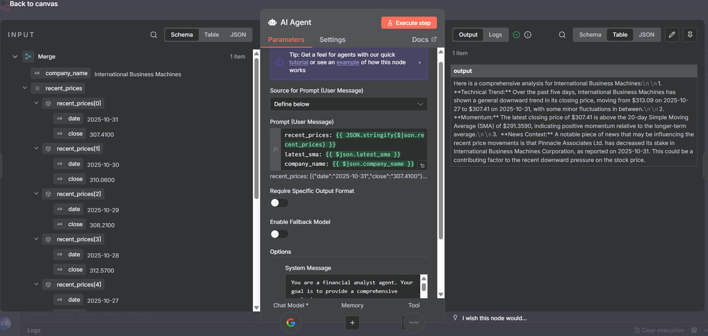
Part 2: The AI "Brain"
The 'Real Time AI Agent'
This is the core of the workflow. It's a powerful node that can:
•
Receive the merged technical data.
•
Connect to a chat model (like Google Gemini).
•
Connect to and use tools (like SerpApi).
It acts as the "brain" that coordinates all the data and tools.

Slide 8
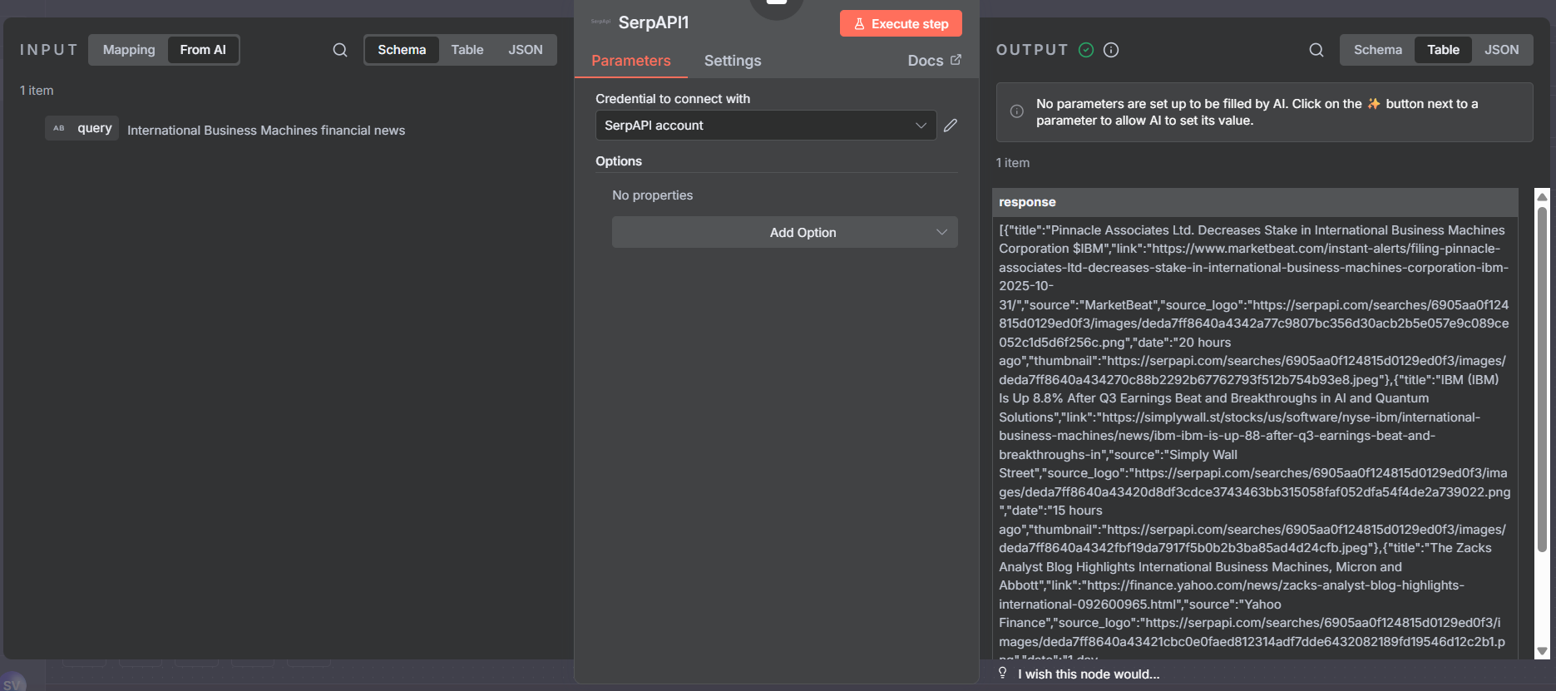

Part 3: The "Agentic" Tool
Giving the AI a Tool: SerpApi
This is what makes the bot truly "smart." The AI isn't just summarizing the data we give it.
Based on our prompt, the AI *decides* to use the `SerpApi` tool. It formulates its own search query (e.g., "Microsoft financial news") to find the "why" behind the price trend, all in real-time.

Slide 9
The Master Prompt: AI Instructions
You are a financial analyst agent. Your goal is to provide a comprehensive analysis.
First, you will be given technical data from the previous node. This includes:
- `recent_prices`: 5-day price history
- `latest_sma`: 20-day SMA
- `company_name`: The company's name
Second, you MUST use the `SerpApi` tool to find out *why* the price has moved. Formulate a good `search_query` (like the company's name + "financial news") to get this context.
Finally, synthesize *all* information (technicals + news) into a single, comprehensive answer for the user.
Your final answer to the user must include:
1. **Technical Trend:** The 5-day price trend.
2. **Momentum:** If the price is above/below the 20-day SMA.
3. **News Context:** The *most important* news headline or snippet that seems to be driving the price.
**IMPORTANT:** Do not give any financial advice, predictions, or suggestions to buy, hold, or sell.
— System Message for the Real Time AI Agent

Slide 10
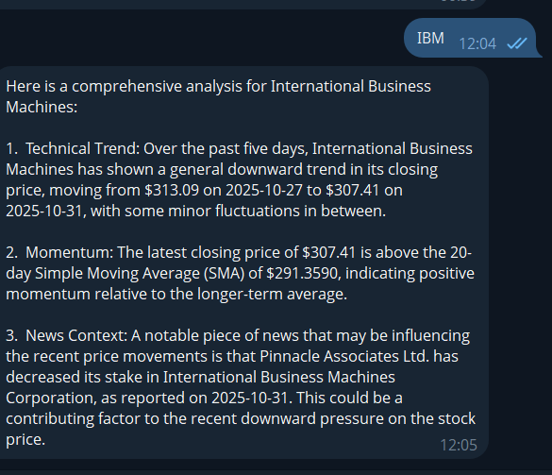
The Final Synthesis
One Message, Full Context
The final output combines all three data points into a single, easy-to-read analysis:
1.
Technical Trend: The 5-day price action.
2.
Momentum: The price vs. its 20-day SMA.
3.
News Context: The key headlines that are driving the movement.
All of this is generated in seconds from a single user message.

Slide 11
Future Enhancements
Persistent Logging: Use the Google Sheets node as a tool to log every analysis the bot performs for future reference.
More Indicators:Add more parallel branches to fetch other indicators like `RSI` or `MACD` and feed them to the AI.
Batch Processing: Add a Google Sheets *trigger* to run the analysis on a list of 20 stocks every morning.
Robust Error Handling: Add `IF` nodes to check for bad API responses (e.g., from a fake ticker) and send a friendly error message.

Slide 12
Questions?
Thank you for your time.

Slide 13







Image Sources
https://community.n8n.io/uploads/default/original/3X/9/0/9094f5847f102ea37b965502a6ddf94874104e01.png
Source: community.n8n.io
https://stack.convex.dev/_next/image?url=https%3A%2F%2Fcdn.sanity.io%2Fimages%2Fts10onj4%2Fproduction%2F49ce17fbf26b70c351ff6153d562369057aa8d3d-2198x1396.png&w=3840&q=75
Source: stack.convex.dev
https://learn-attachment.microsoft.com/api/attachments/c7623ca7-c617-476b-b4b5-627304c909a0?platform=QnA
Source: learn.microsoft.com
https://i.ytimg.com/vi/2OVLa9WGrtg/hq720.jpg?sqp=-oaymwEhCK4FEIIDSFryq4qpAxMIARUAAAAAGAElAADIQj0AgKJD&rs=AOn4CLDfr1vs40lbCPaZYVbpDyXfkWgJag
Source: www.youtube.com

